Slide 1
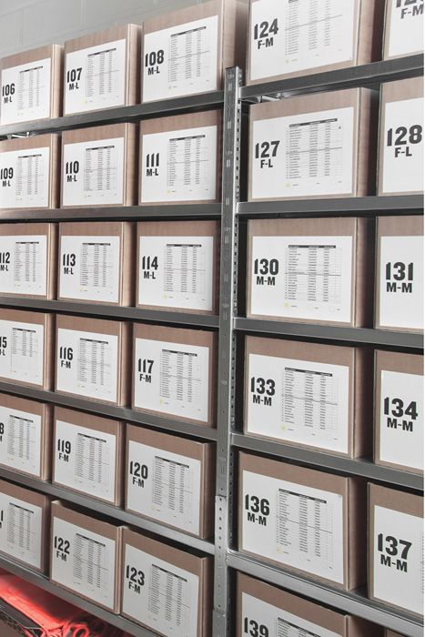
Inventory Management
How to Effectively Manage Your Inventory

Slide 2
Index
1
Project Name
2
User Action diagram
3
Dialog design
4
Table Schema

Slide 3

Part 1
Project Name

Slide 4

E Z M G
Easy Manage your Inventory!

Slide 5

Part 2
User Action diagram

Slide 6
User Action Diagram
Login Part
Join
>>
Sign Up
Join
Login Button
>>
DB Open
>>
( UserINFO )
>>
Login
Login success
>>
Menu Select
Part
Login success
Login success

Slide 7
User Action Diagram
Menu Select Part
Menu Select
Part
>>
>>
My
Inventory
Purchase
Orders
>>
DB Open
( InventoryDetails )
Add
Delete
Order
Join
>>
>>
Order
Confirmation
Create
Read
Update
Delete
Search

Slide 8
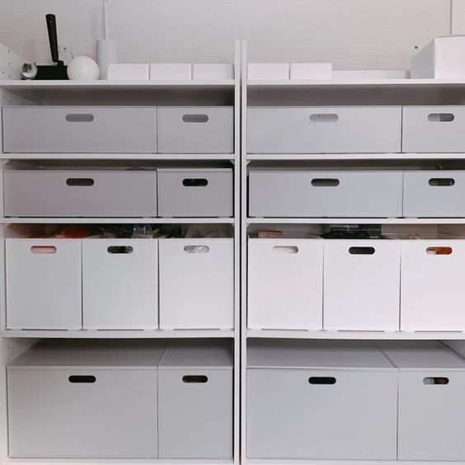
Part 3
Dialog design

Slide 9
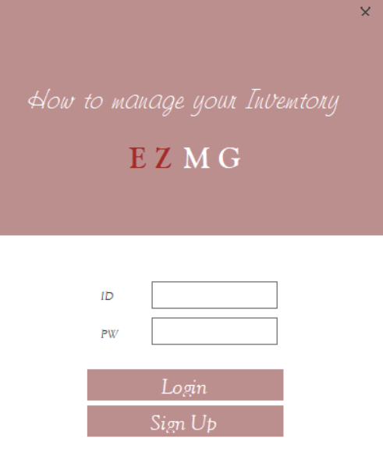
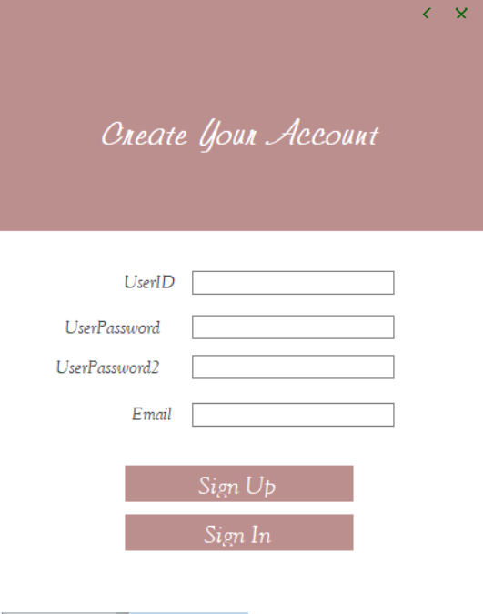
Dialog design

Slide 10
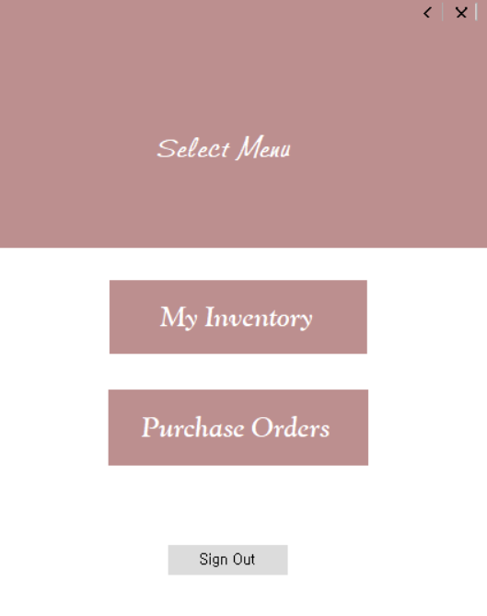
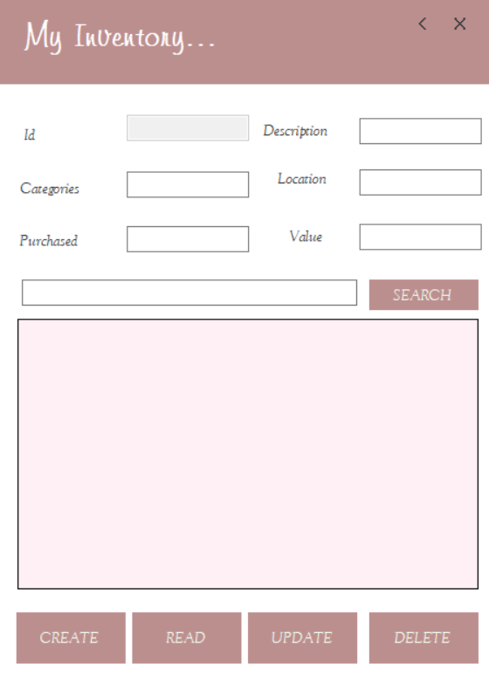
Dialog design

Slide 11
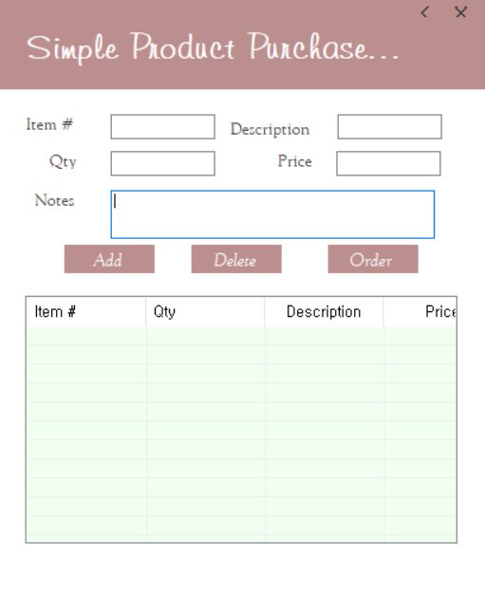
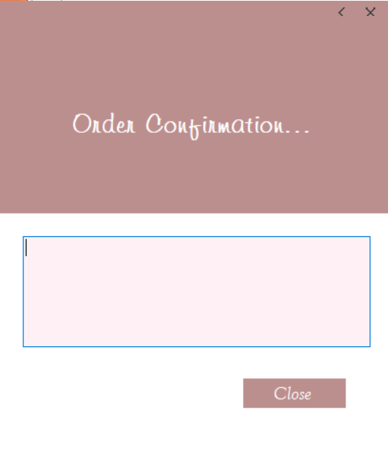
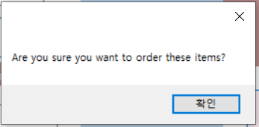
Dialog design

Slide 12

Part 4
Table Schema

Slide 13
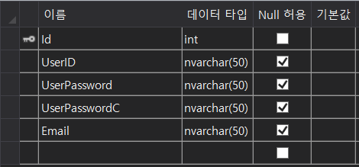
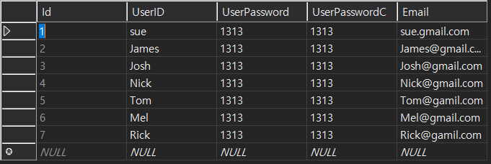
Table Schema
UserINFO
>>

Slide 14
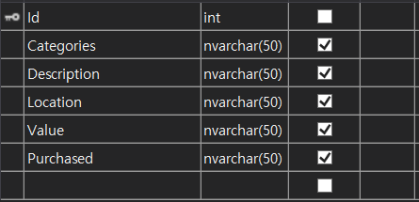
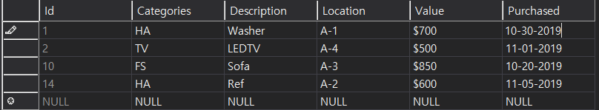
Table Schema
InventoryDetails
InventoryDetails
>>

Slide 15

Thank you!

